Slide 1
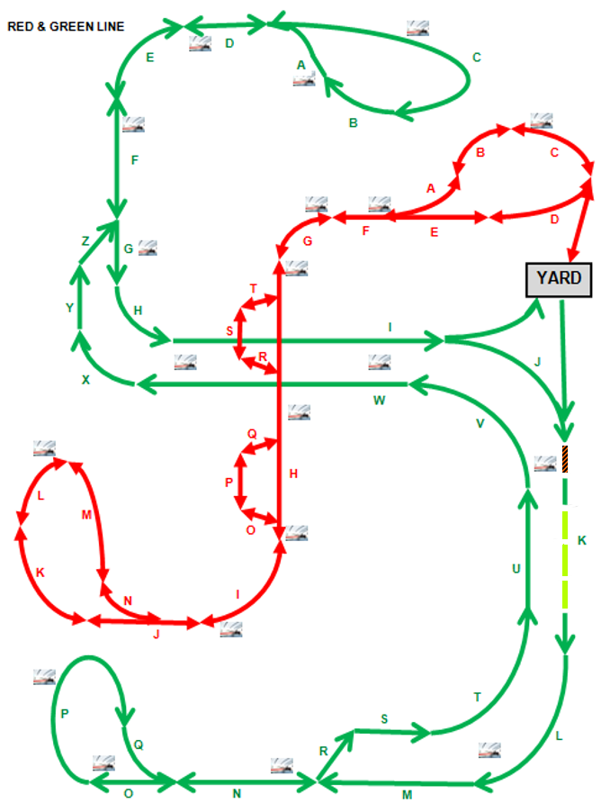

CTC OFFICE
Current Throughput: 4 Trains
Train ID | Speed (m/sec) | Authority (Blocks) | Current Block | Target Block
001 | 0 | 0 | 1 | 16
010 | 18 | 13 | 15 | 2
013 | 15 | 10 | 35 | 50
210 | 5 | 20 | 66 | 72
Sample Track Display
Occupied
Closed
Open
Close

